Slide 1
GeoCoder Project and TriMet
Thoughts on what we're going to need,
both short-term development
and long-term support
November 2016

Slide 2
SOLR: current schema
https://github.com/OpenTransitTools/loader/blob/master/ott/loader/solr/conf/schema.xml#L129
SOLR has fields for both Stop ID and Route ID
SOLR has an inclusive search parameter, thus limiting to a sub-set of the index (Stops)
And an exclude param hiding certain types (TVMs)
SOLR returns fields for in/out TriMet boundary
Type names can be queried against (Parks)
Type boosting (Stops) and sorting (City)
TriMet has apps (internal) that use the OSPN X & Y coords...have to change those.

Slide 3
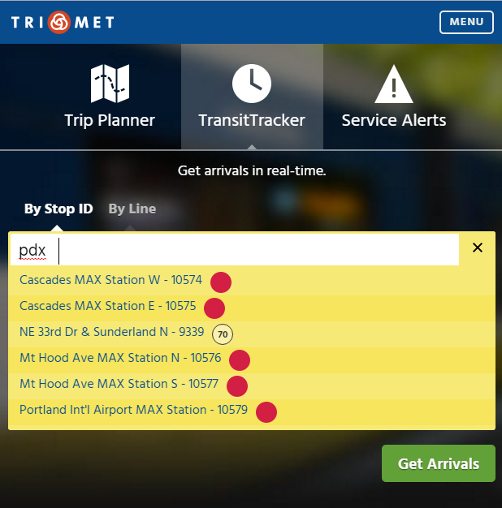
trimet.org – Stop & Route info
Things to look at:
SOLR on TransitTracker tab
Stops Only query
Route data in SOLR response

Slide 4
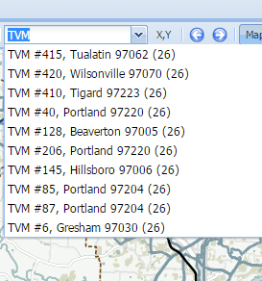
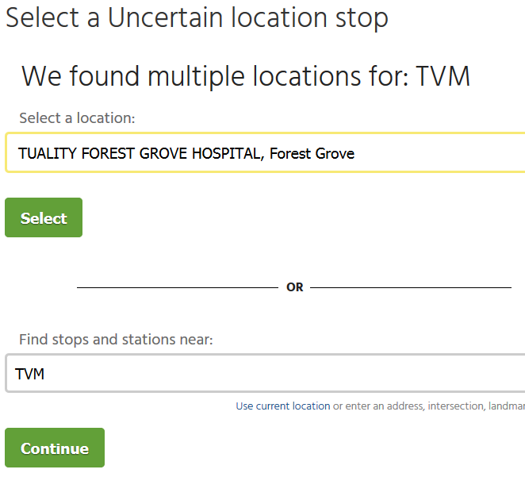
Filter point types for different apps
Things to look at:
In the internal map apps, we'll show things like TVMs (ticket vending machines)
The public doesn't care about searching on TVMs, so we filter them from public apps. Searching for TVM on a public site does not return the TVM list
SOLR has both an inclusive search filter (e.g., Stop type), and an exclude filter that we can use to avoid certain types from the search.

Slide 5
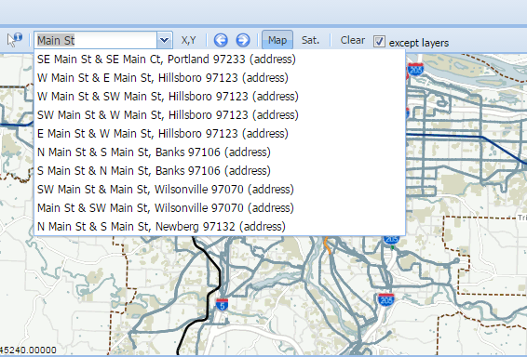
SOLR – city sorting
Things to look at:
SOLR has a higher weight on Portland addresses compared to all other cities. Hillsboro, Gresham and Beaverton are higher than other cities, etc...

Slide 6
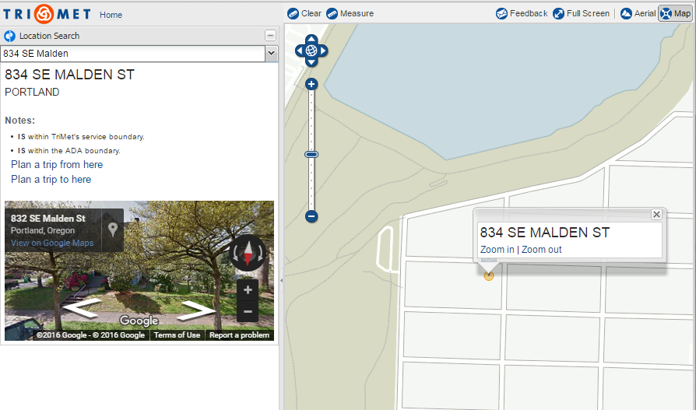
Mobilitymap's in/out Boundary Info
Things to look at:
In addition to LIFT, the DOR uses the map to determine if a business is in/out of the TriMet district for TM-tax purposes.
This same in/out of TriMet info from the geocoder appears on a public district / tax page on trimet.org for the general public.

Slide 7
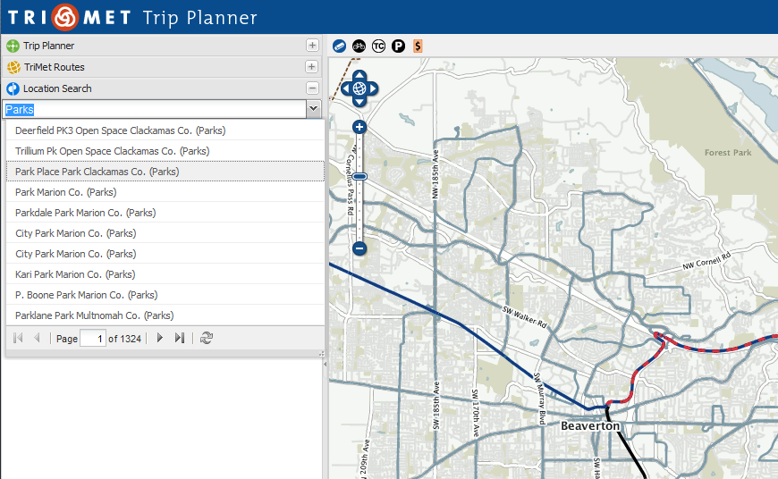
Search on Type Names
Things to look at:
There are 18 different types (classifications) of content in SOLR
There is an English type name that can be used as a query keyword, thus bringing up all of those types
It was a requirement at one point to have a query of all 'Parks' show as a geosearch result.

Slide 8
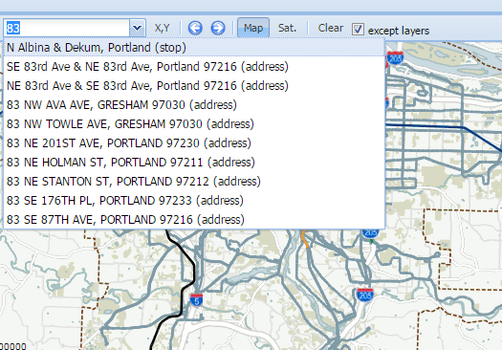
SOLR – stop weighting
Things to look at:
SOLR is configured to prefer records with Stops IDs, and thus list those higher than other (address) records

Slide 9
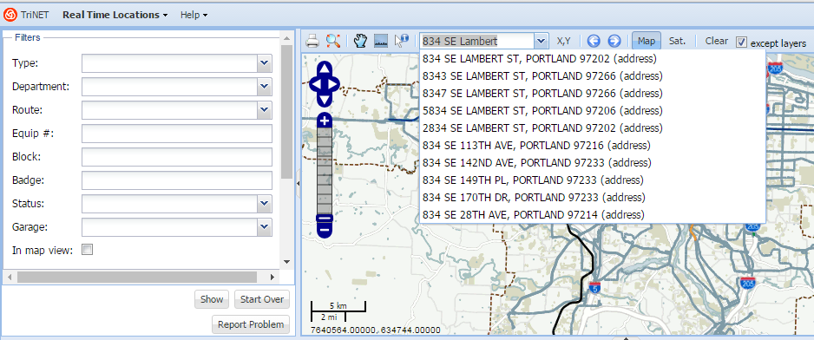
Internal maps use OSPN X & Y
Things to look at:
All of the internal maps will need to be changed to use Pelias
These apps will need to re-project Pelias' Lat & Lons into OSPN X & Y coordinates (or maybe the maps get updated away from using OSPN).

Slide 10
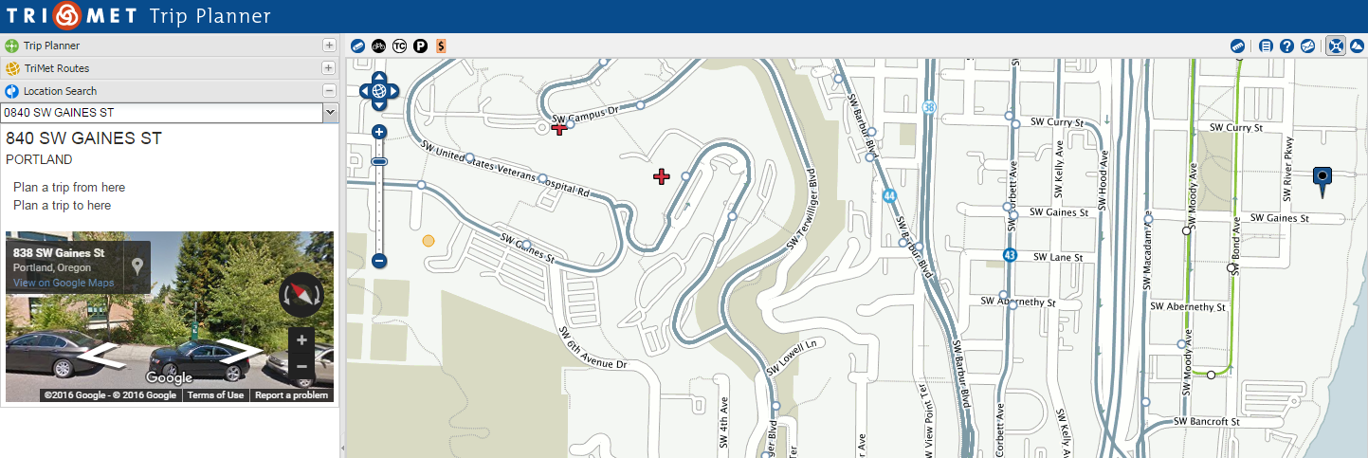
840 and 0840 SW Gaines
Things to look at:
Portland has a weird numbering scheme of leading zeros addresses. The blue marker at map-right is 0840 SE Gaines St.
About 1 mile west of 0840 SW Gaines St is a building with an address of 841 SW Gaines St.
Creating address ranges might get somewhat tricky here; searches for 0840 SW... and 840 SW... could get interesting.

Slide 11
Pelias: help needed
consultants to show Frank Purcell and Grant Humphries how to run the ETL tools
consultants (on-site and electronic availability) from MapZen to work with John Zimmerman (JZ) to install Pelias and all related ETL tools in his server environment
consultants to set up a support mechanism between Myleen Richardson & Madeline Steele, and respond to their ongoing questions & feedback when they encounter end-user issues with the geocoder
Address Patching Scheme (e.g., maf_fixes.csv)

Slide 12
Pelias: Potential Challenges
The ATIS geocoder took 10 years to stabilize
Myleen & Madeline (M&M) are going to take the brunt of this project long term (see ATIS above)
Project Success (measured as zero customer complaints) will require a feedback -> fix -> deploy loop involving M&M, MapZen and (to a lesser extent) JZ
I believe Pelias will have issues with things like ZERO-leading address points … they’ll be other issues (there always are)
All new systems require effort beyond SW dev

